Slide 1
CONSTRAINT SATISFACTION PROBLEMS
Course Code: CSC4226
Course Title: Artificial Intelligence and Expert System
Dept. of Computer Science
Faculty of Science and Technology
Lecture No: | Eight (7) | Week No: | Eight (8) | Semester:
Lecturer: | Dr. Ashraf Uddin dr.ashraf@aiub.edu

Slide 2
Lecture Outline
Defining CSP
Varieties of CSPs
Backtracking Search for CSPs
Forward Checking
Constraint Propagation
Heuristics for CSP
Problem Structure

Slide 3
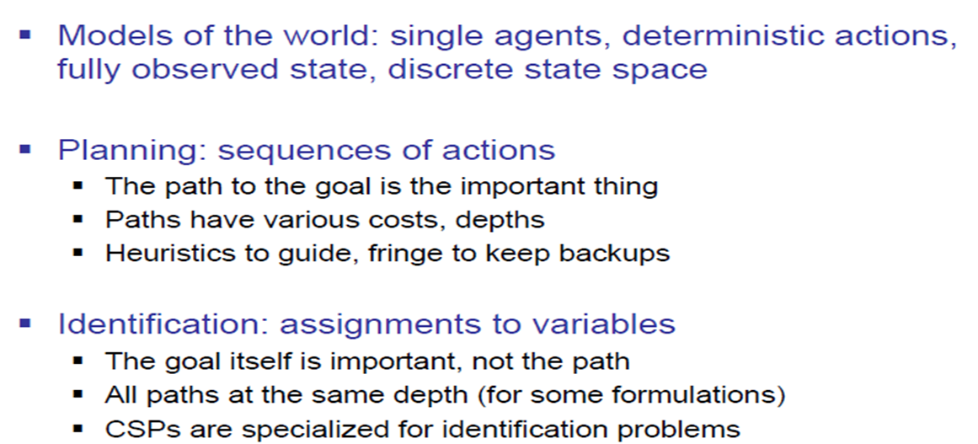
What is Search For?

Slide 4
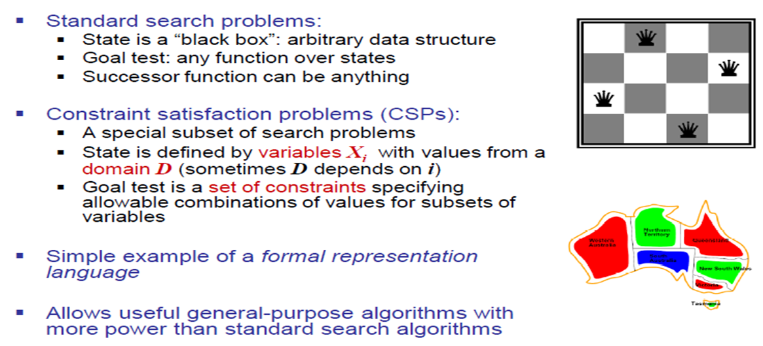
Constraint Satisfaction Problems

Slide 5
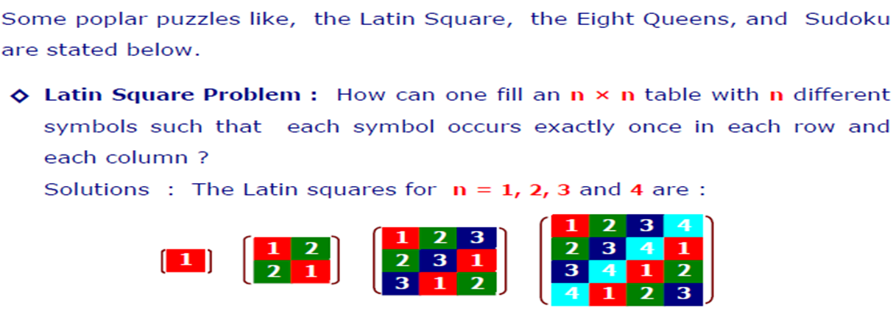
Example of CSPs

Slide 6
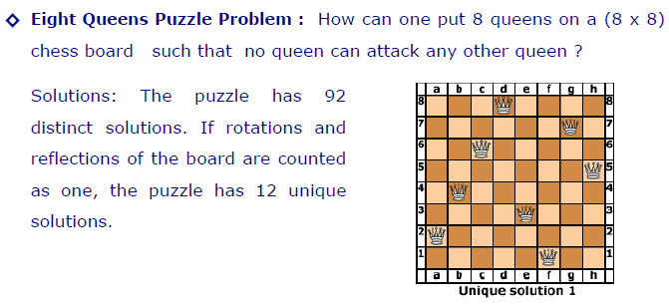
Example of CSPs

Slide 7
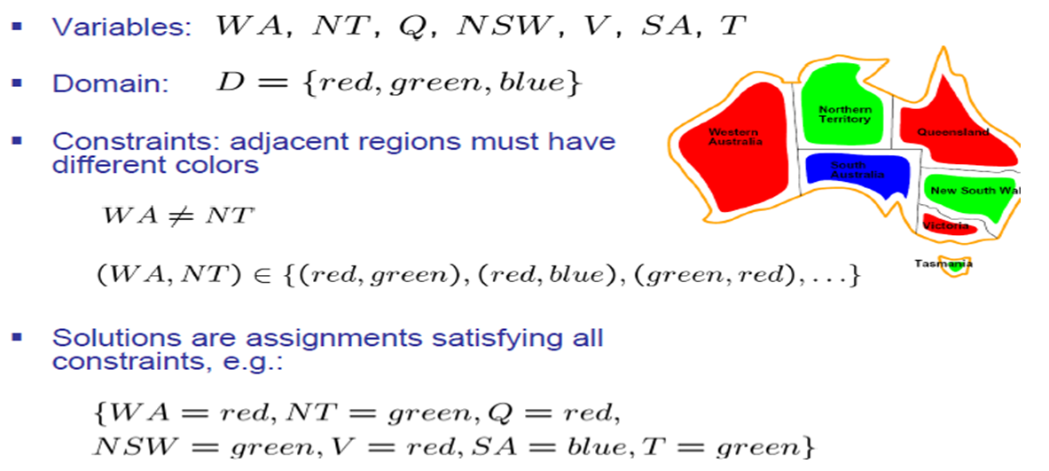
Example CSP: Map Coloring

Slide 8
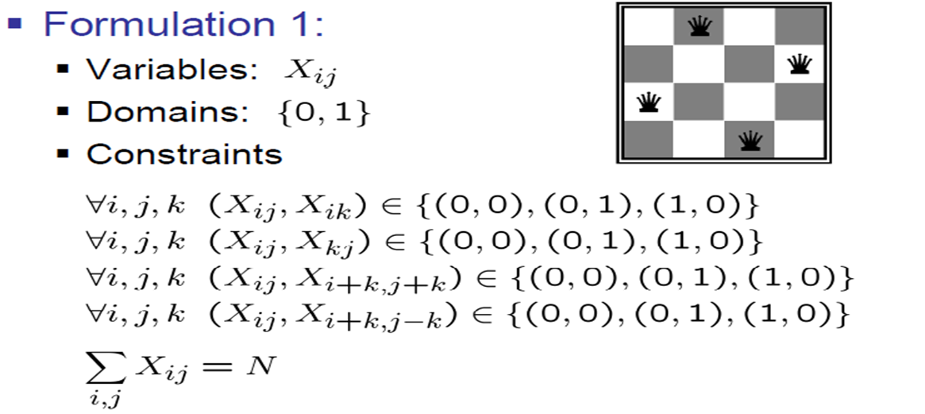
Example: N-Queens

Slide 9
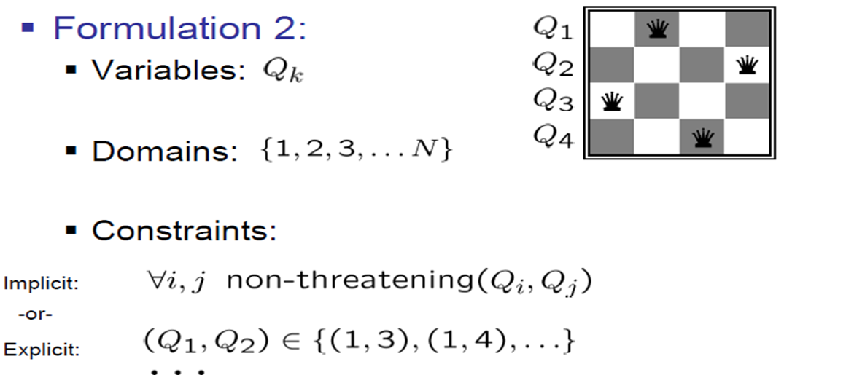
Example: N-Queens

Slide 10
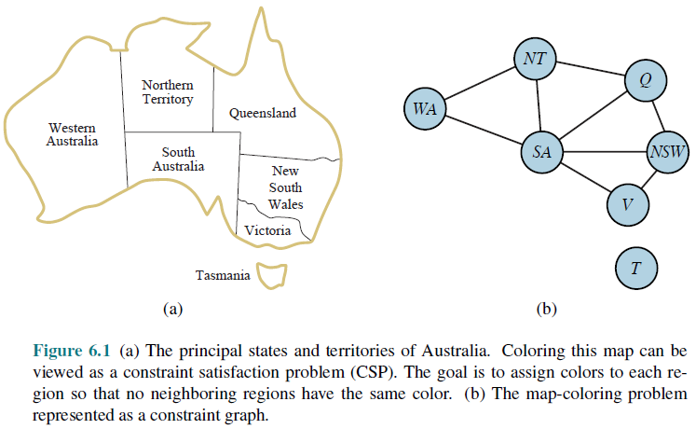
Constraint Graph

Slide 11
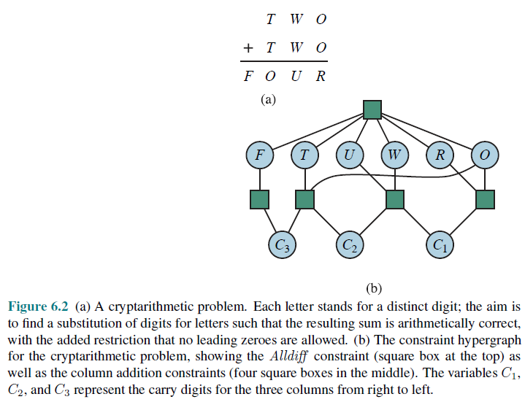
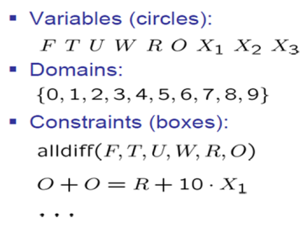
Example CSP: Cryptarithmetic

Slide 12
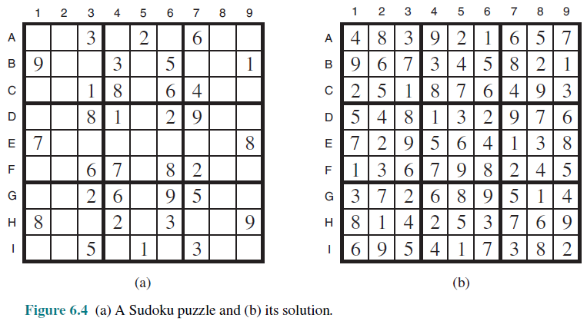
Example: Sudoku

Slide 13
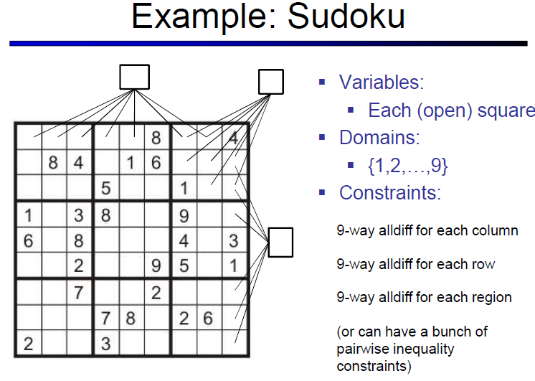
Topic Heading..

Slide 14
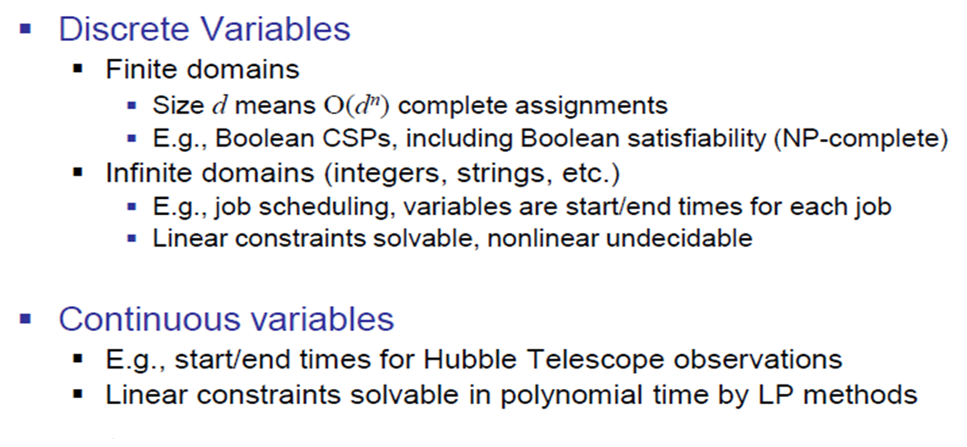
Varieties of CSPs

Slide 15
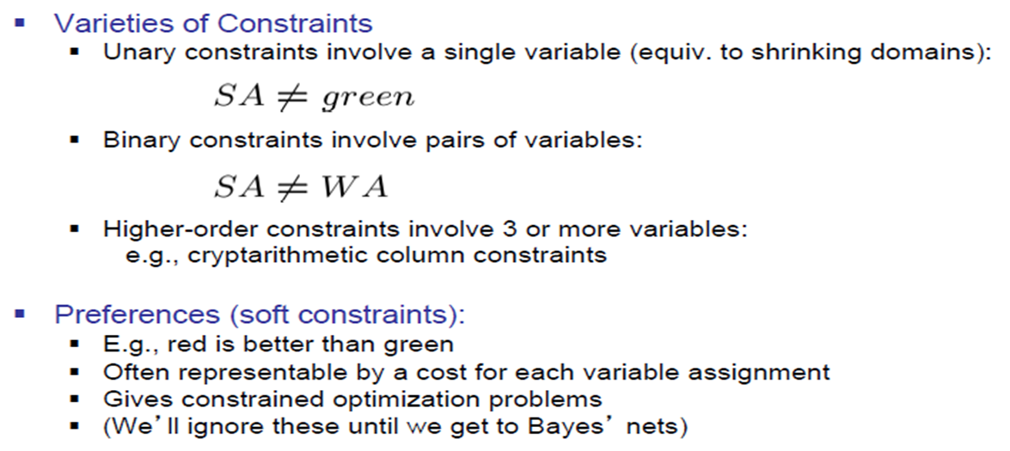
Varieties of Constraints

Slide 16
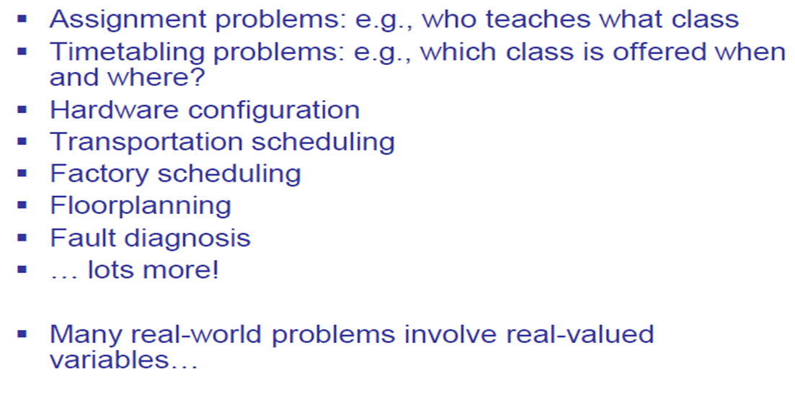
Real World CSPs

Slide 17
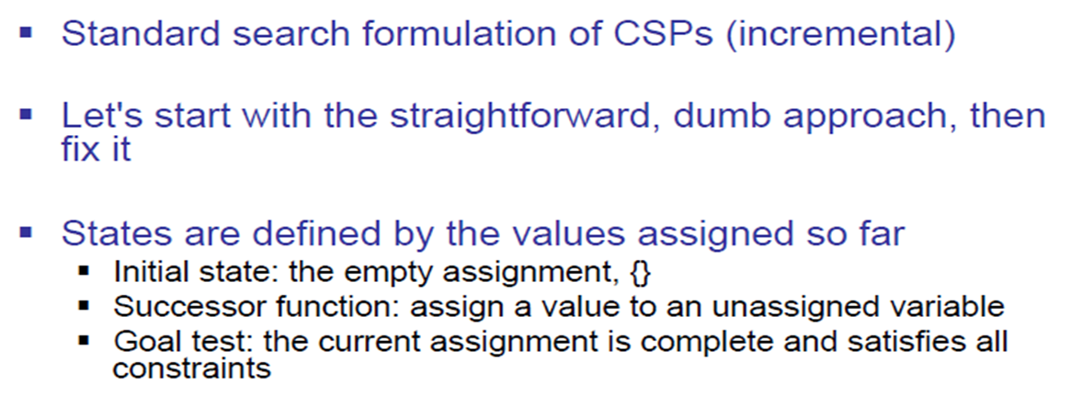
Standard Search Formulation

Slide 18
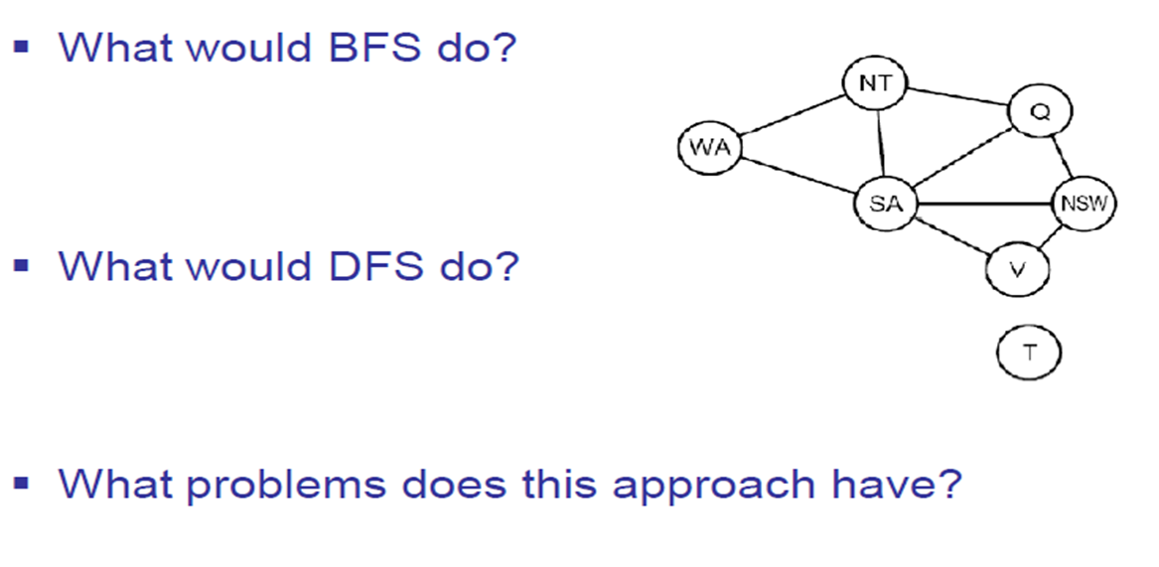
Search Methods

Slide 19
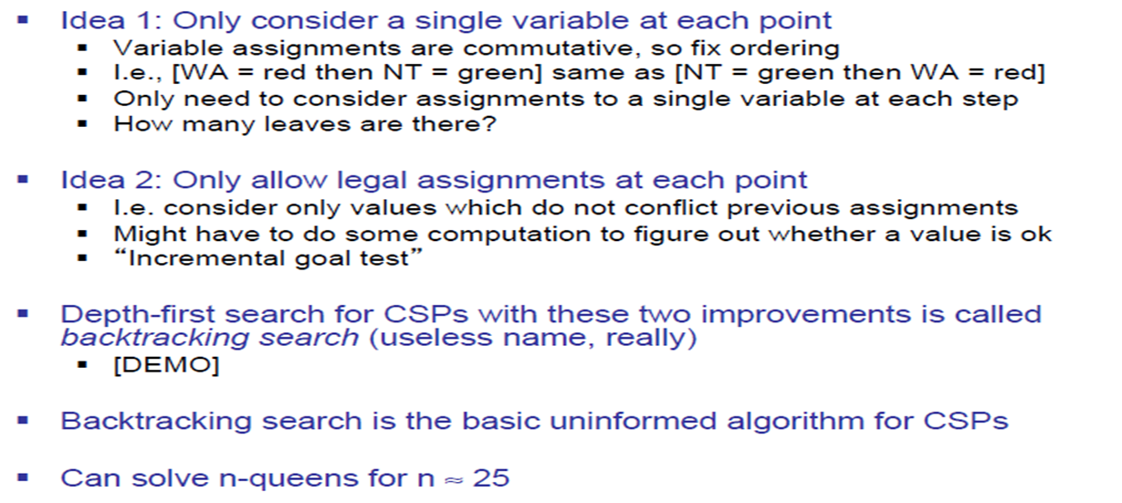
Backtracking Search

Slide 20
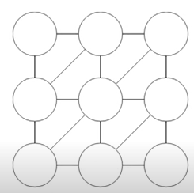
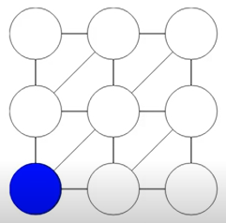
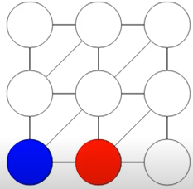
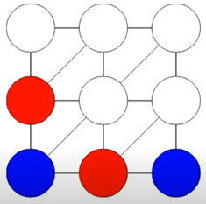
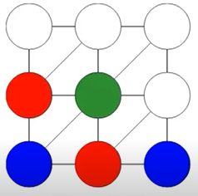
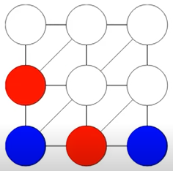
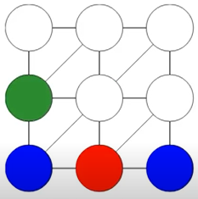
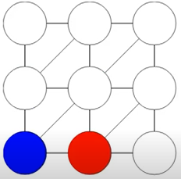
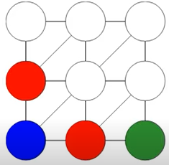
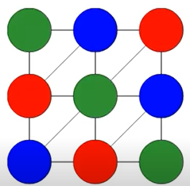
Demonstration
Assigning Value from Domain = { Blue, Red, Green} To Each Variables (circles)
from Left to Right Order
NO COLOR TO ASSIGN NEXT. BACKTRACK

Slide 21
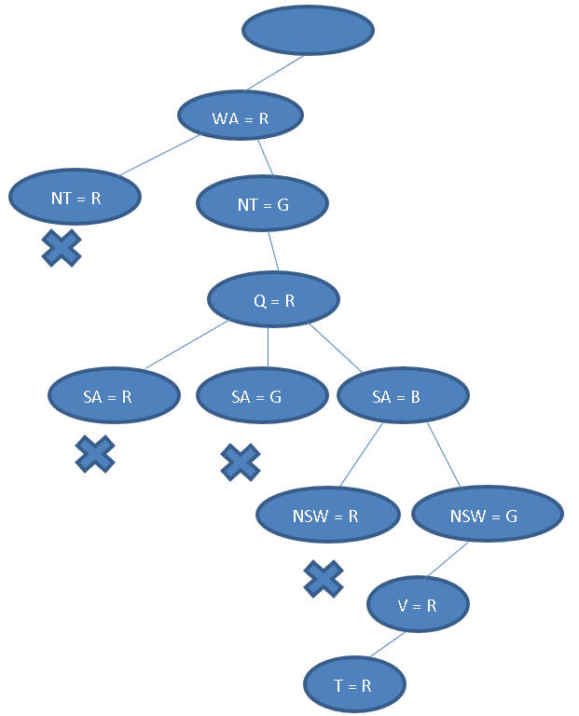

Backtracking Example
V = {WA, NT, Q, SA, NSW, V, T}
D = {R, G, B}
C = {WA≠NT, WA≠SA, NT≠SA, NT≠Q, SA≠Q, Q≠NSW, SA≠NSW, V≠NSW, SA≠V}

Slide 22
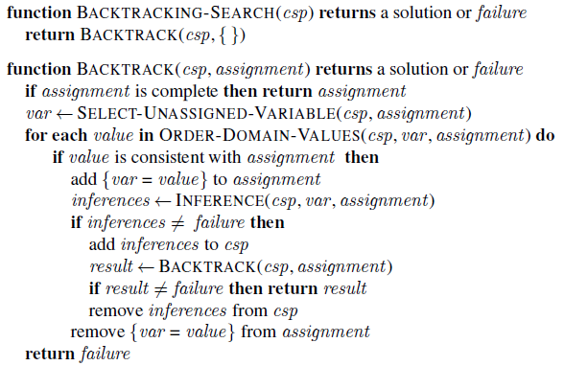
Backtracking Search

Slide 23
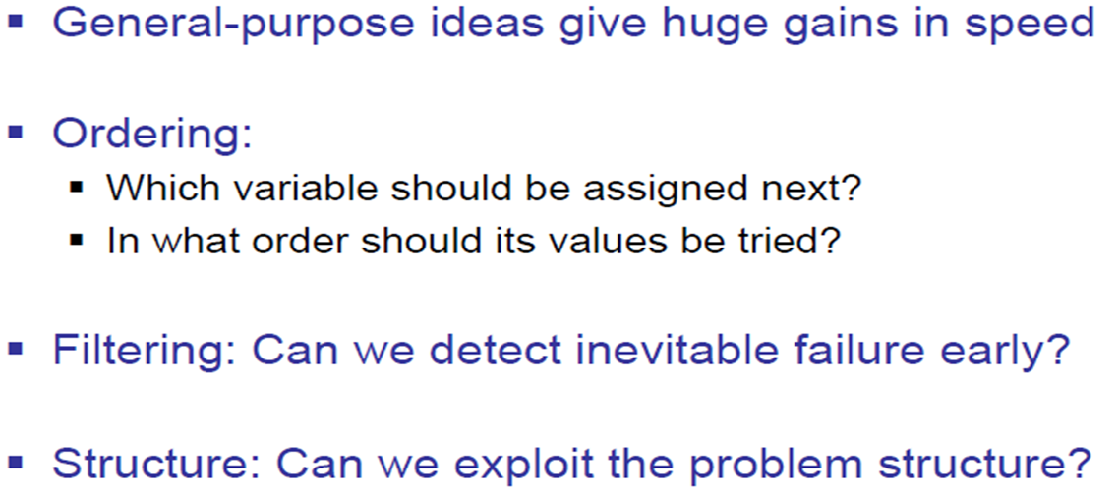
Improving Backtracking

Slide 24
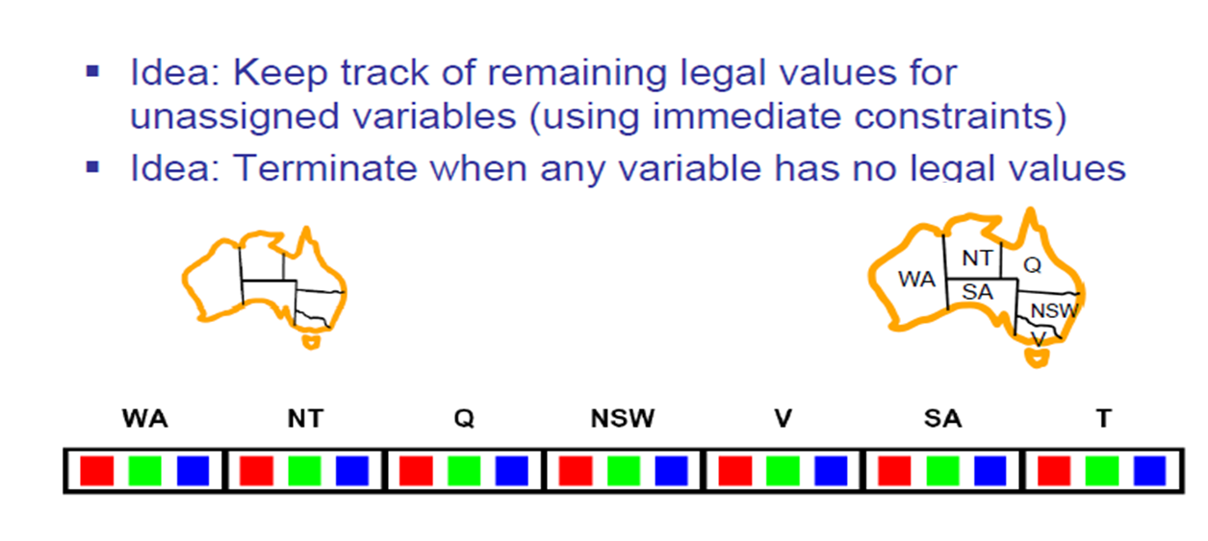
Filtering: Forward Checking

Slide 25
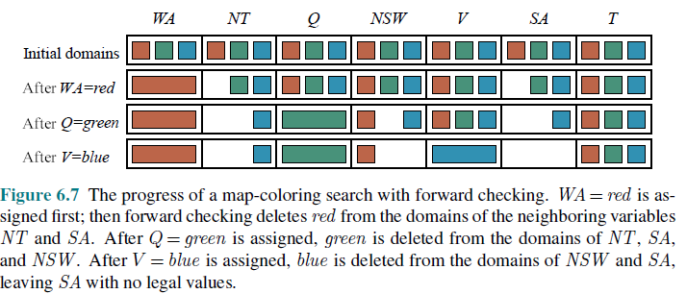
Filtering: Forward Checking

Slide 26
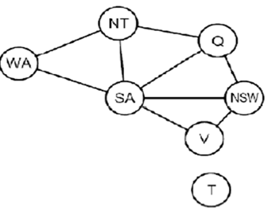
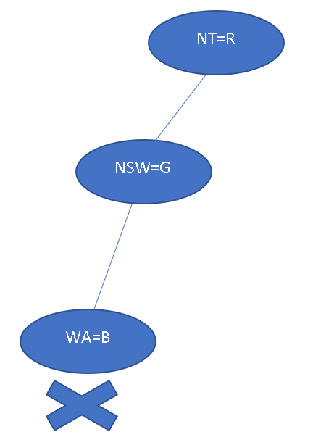
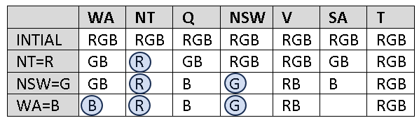
Filtering: Forward Checking
Another example

Slide 27
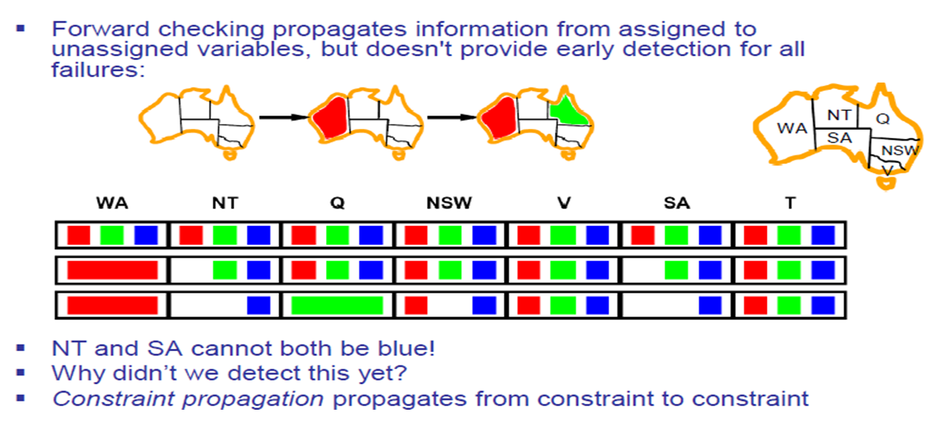
Filtering: Constraint Propagation

Slide 28
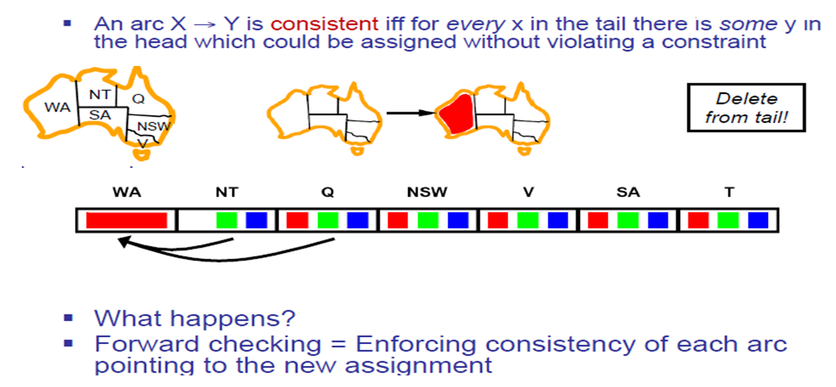
Consistency of An Arc

Slide 29
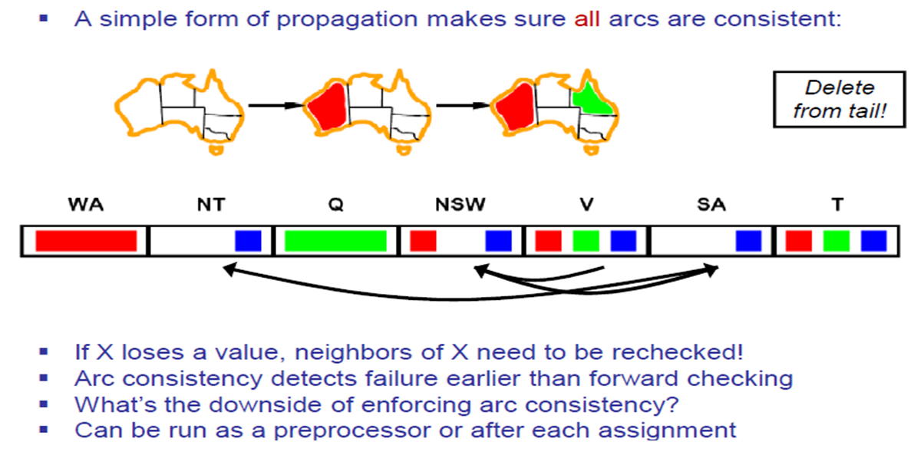
Arc Consistency of a CSP

Slide 30
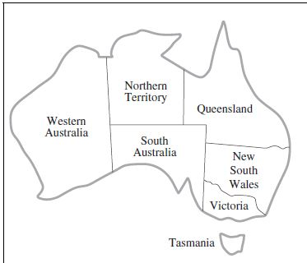
Arc Consistency of a CSP
Variable
WA = {R, G, B}
NT= {R, G, B}
Q= {R, G, B}
NSW= {R, G, B}
V = {R, G, B}
SA= {R, G, B}
T= {R, G, B}
Constraints
SA≠WA
SA≠NT
SA≠Q
SA≠NSW
SA≠V
WA≠NT
NT≠Q
Q≠NSW
NSW≠V
Constraints
WA≠SA
NT≠SA
Q≠SA
NSW≠SA
V≠SA
NT≠WA
Q≠NT
NSW≠Q
V≠NSW

Slide 31
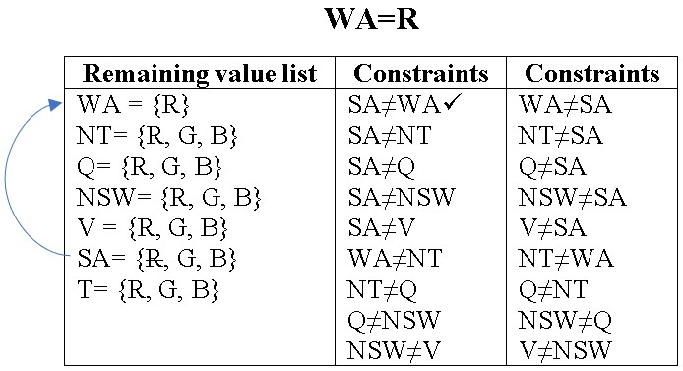
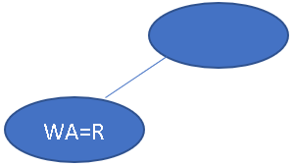
Arc Consistency of a CSP
R is removed from SA for SA≠WA. The checked conditions are marked with ✓

Slide 32
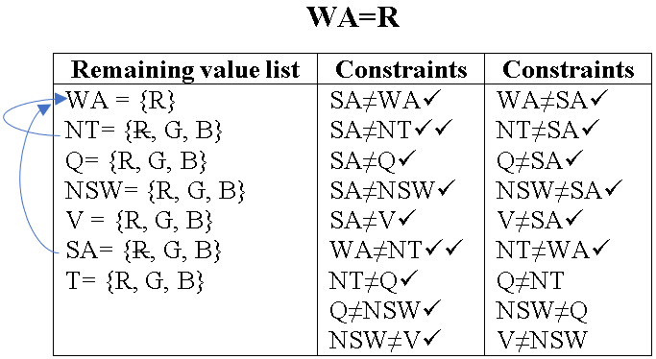
Arc Consistency of a CSP
No value is removed for the conditions from SA≠NT to V≠SA but R is removed for NT≠WA. So, we need to recheck the conditions SA≠NT and WA≠NT (marked with ✓✓) and no value was removed for these.

Slide 33

Arc Consistency of a CSP
Then, we check the remaining conditions (Q≠NT, NSW≠Q, V≠NSW) and no change. Here, the process after the first assignment (WA=R) is completed.

Slide 34
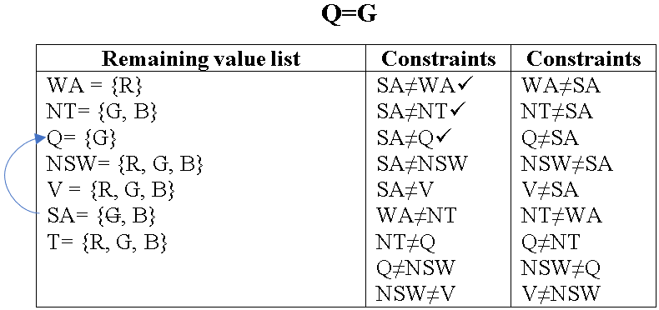
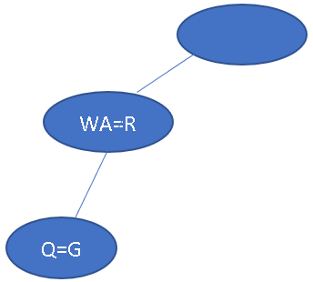
Arc Consistency of a CSP
No value is removed for the conditions SA≠WA and SA≠NT but G is removed for SA≠Q.

Slide 35
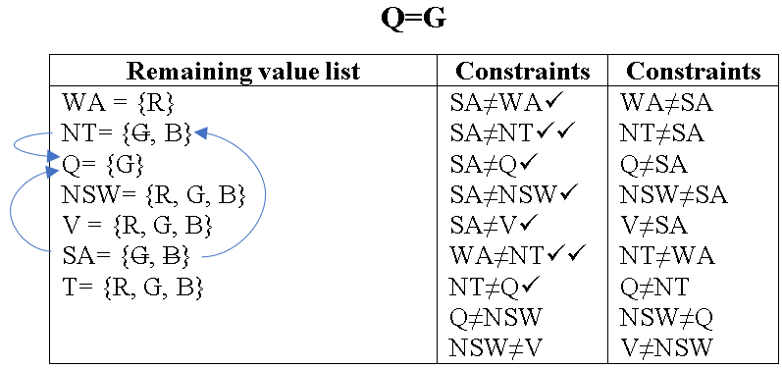
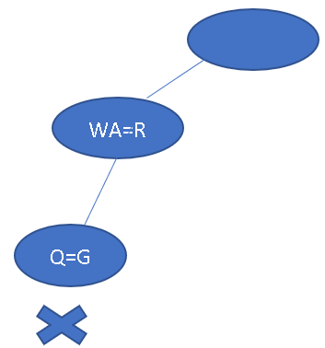
Arc Consistency of a CSP
No value is removed for the conditions SA≠NSW, SA≠V and WA≠NT but G is removed for NT≠Q. So, we need to recheck the conditions SA≠NT and WA≠NT. For SA≠NT, B was removed, and B becomes empty. So, we backtracked from here.

Slide 36
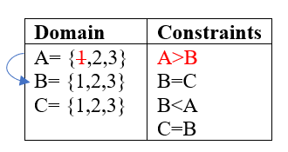
Arc Consistency of a CSP
Identify the values of A, B, C so that the following problem becomes arc consistent: A= {1,2,3}, B= {1,2,3}, C= {1,2,3} and Constraints: A>B, B=C
V: {A, B, C}
D: A= {1,2,3}, B= {1,2,3}, C= {1,2,3}
C: A>B, B=C

Slide 37
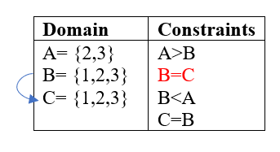
Arc Consistency of a CSP
Identify the values of A, B, C so that the following problem becomes arc consistent: A= {1,2,3}, B= {1,2,3}, C= {1,2,3} and Constraints: A>B, B=C
V: {A, B, C}
D: A= {1,2,3}, B= {1,2,3}, C= {1,2,3}
C: A>B, B=C

Slide 38
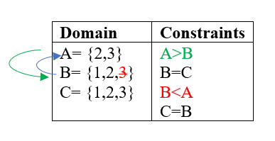
Arc Consistency of a CSP
Identify the values of A, B, C so that the following problem becomes arc consistent: A= {1,2,3}, B= {1,2,3}, C= {1,2,3} and Constraints: A>B, B=C
V: {A, B, C}
D: A= {1,2,3}, B= {1,2,3}, C= {1,2,3}
C: A>B, B=C

Slide 39

Arc Consistency of a CSP
Identify the values of A, B, C so that the following problem becomes arc consistent: A= {1,2,3}, B= {1,2,3}, C= {1,2,3} and Constraints: A>B, B=C
V: {A, B, C}
D: A= {1,2,3}, B= {1,2,3}, C= {1,2,3}
C: A>B, B=C
Now A= {2,3}, B= {1,2}, C= {1,2} are arc consistent.

Slide 40

Exercise
For the given map
Find a valid map coloring using backtracking
Perform 3 steps of forward checking
Perform 2 steps of constraint propagation
Consider variable and value ordering as your choice. Use red, green and blue to color the map.

Slide 41

Exercise
For the given map
Find a valid map coloring using backtracking
Perform 3 steps of forward checking
Perform 2 steps of constraint propagation
Consider variable and value ordering as your choice. Use red, green and blue to color the map.

Slide 42

Topic Heading..

Slide 43

Heuristic for Variable Ordering: Minimum Remaining Value

Slide 44

Heuristic for Value Ordering : Least Constraining Value

Slide 45

Problem Structure
Dividing a Boolean CSP with 80 variables into four sub problems reduces the worst-case solution time from the lifetime of the universe down to less than a second

Slide 46

Tree Structure CSPs

Slide 47

Topic Heading..

Slide 48

Topic Heading..

Slide 49


Slide 50

Tree Decomposition

Slide 51

Summary

Slide 52
References
Chapter 6: Introduction , Pages 202-220
“Artificial Intelligence: A Modern Approach,” by Stuart J. Russell and Peter Norvig,

Slide 53
Books
“Artificial Intelligence: A Modern Approach,” by Stuart J. Russell and Peter Norvig.
"Artificial Intelligence: Structures and Strategies for Complex Problem Solving", by George F. Luger, (2002)
"Artificial Intelligence: Theory and Practice", by Thomas Dean.
"AI: A New Synthesis", by Nils J. Nilsson.
“Programming for machine learning,” by J. Ross Quinlan,
“Neural Computing Theory and Practice,” by Philip D. Wasserman, .
“Neural Network Design,” by Martin T. Hagan, Howard B. Demuth, Mark H. Beale, .
“Practical Genetic Algorithms,” by Randy L. Haupt and Sue Ellen Haupt.
“Genetic Algorithms in Search, optimization and Machine learning,” by David E. Goldberg.
"Computational Intelligence: A Logical Approach", by David Poole, Alan Mackworth, and Randy Goebel.
“Introduction to Turbo Prolog”, by Carl Townsend.

